Slide 1
Shell Bootcamp 2024 3 Reflections for Week #<>
<Name>
Date : 30-Aug-2024

Slide 2

About Me
Learning never stops

Slide 3

My learnings from this week!

Slide 4
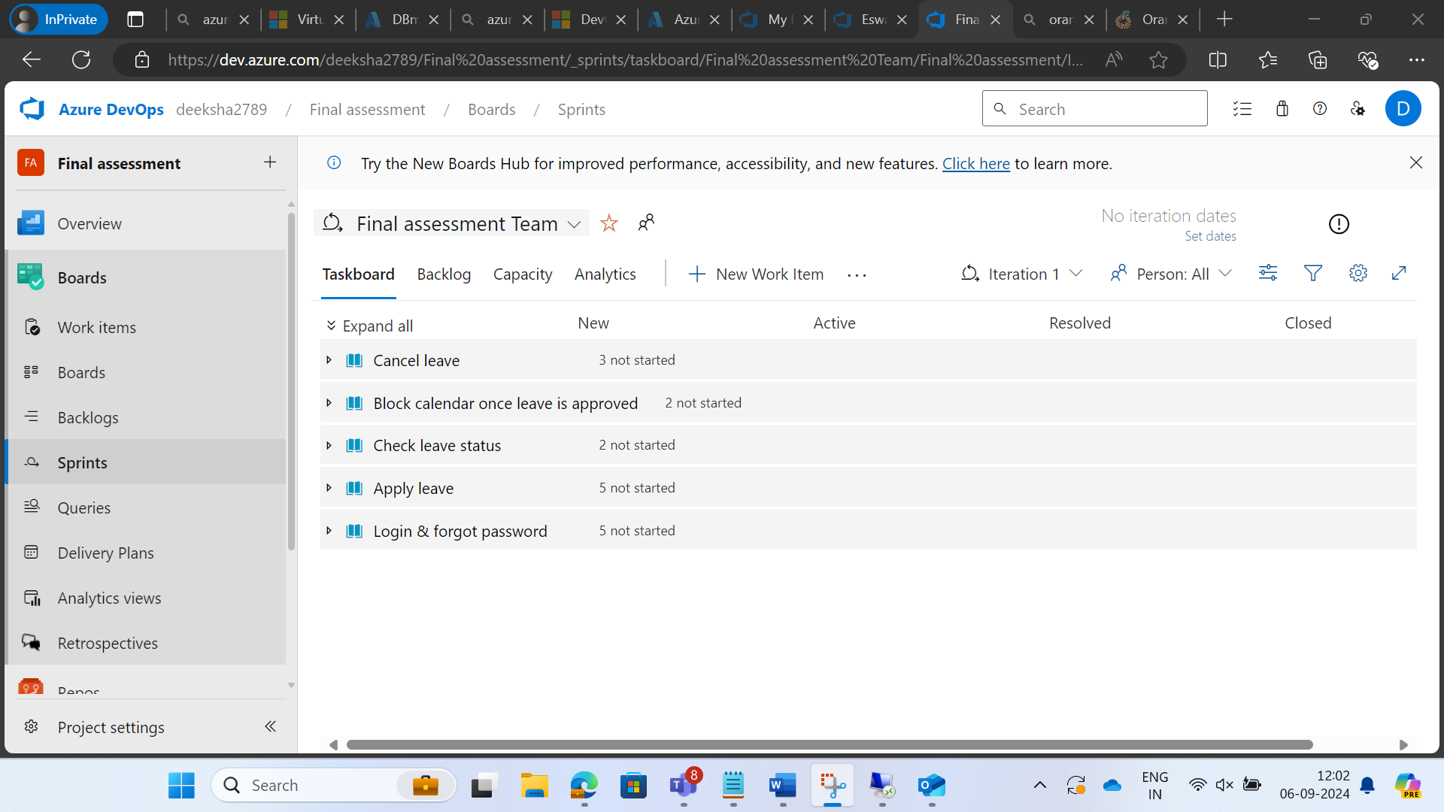
Learning 1 | My takeaways
Please share (in your own words) details of the learning.
Key learning - AzureDevops
Key takeaway – how to make sprints, add tasks, run tests and scrumm meetings
How do I personally see this concept implemented in the Energy sector – this shall be used to better coordinate work flow and enhance communication

Slide 5
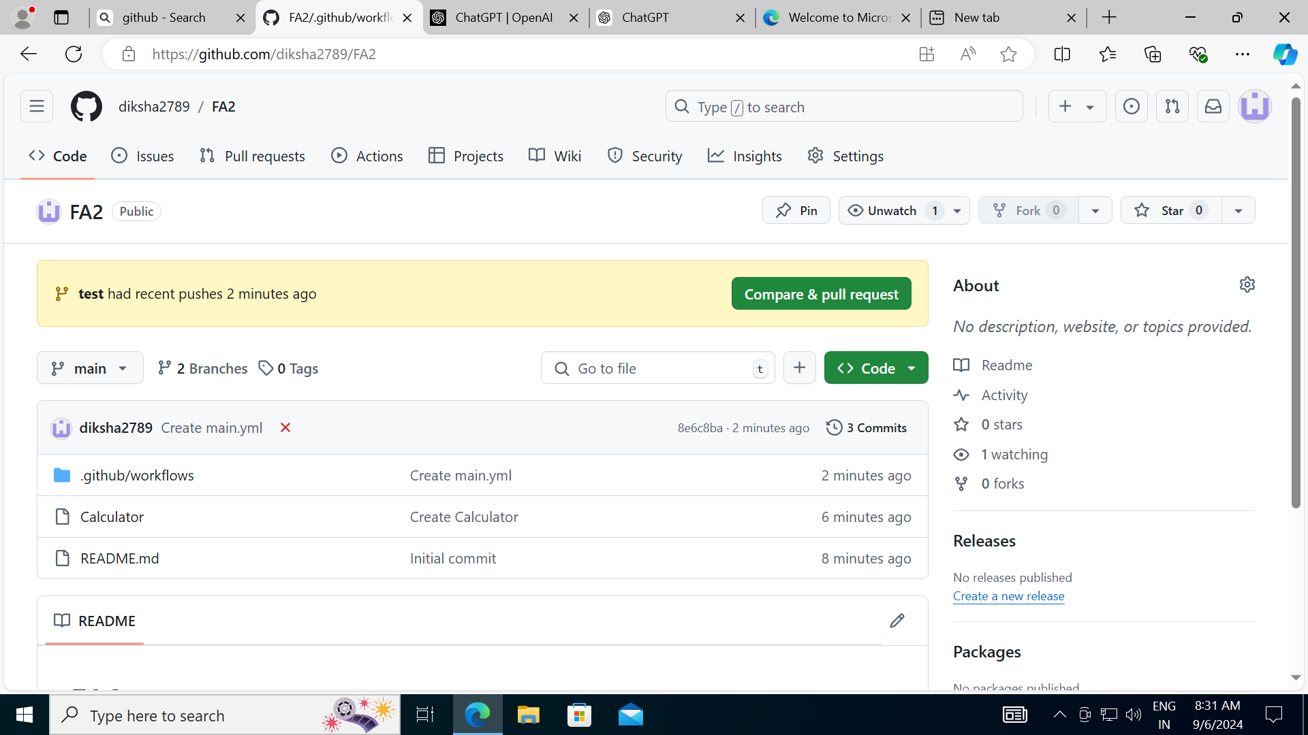
Learning 2 | My takeaways
Please share (in your own words) details of the learning.
Key learning - GitHub
Key takeaway – how to create a repository, commit changes, pull requests, branches, workflow
How do I personally see this concept implemented in the Energy sector – will be used in day to day work

Slide 6

Learning 3 | My takeaways
Please share (in your own words) details of the learning.
Key learning – cloud
Key takeaway – importance of cloud, keeping up with tech
How do I personally see this concept implemented in the Energy sector – staying upto date with latest tech

Slide 7

Relevance of learnings for my organization

Slide 8
Learning 1 | Relevance for Shell
How I feel Shell implements this learning (in your own words)
Azuredevops is used by all teams in shell
How I feel Shell benefits from this learning (in your own words)
Better understanding of the platform
[Add a graphic that provides view of how Shell implements this learning]

Slide 9
Learning 2 | Relevance for Shell
How I feel Shell implements this learning (in your own words)
GitHub again is used everyday by shell
How I feel Shell benefits from this learning (in your own words)
Better understanding
[Add a graphic that provides view of how Shell implements this learning]

Slide 10
Learning 3 | Relevance for Shell
How I feel Shell implements this learning (in your own words)
Latest tech
How I feel Shell benefits from this learning (in your own words)
Better equipt as an employee
[Add a graphic that provides view of how Shell implements this learning]

Slide 11

Challenges in implementing learning

Slide 12
Challenge faced while implementing Learning 1
What were the challenges I faced while implementing Learning 1 and my plan to overcome them
A bit too much in the beginning
Overcame through practice
GitHub link of your solution/documentation
https://github.com/diksha2789/final-case-study-
[Add a graphic that provides evidence of what you did to overcome this challenge]

Slide 13
Challenge faced while implementing Learning 2
What were the challenges I faced while implementing Learning 2 and my plan to overcome them
Decent amount of coding involved
Practice to overcome
GitHub link of your solution/documentation
[Add a graphic that provides evidence of what you did to overcome this challenge]

Slide 14
Challenge faced while implementing Learning 3
What were the challenges I faced while implementing Learning 3 and my plan to overcome them
GitHub link of your solution/documentation
[Add a graphic that provides evidence of what you did to overcome this challenge]

Slide 15

Action Plan

Slide 16
My Action Plan for this Week
Actions
Timeline
Status
More practice
2 weeks
done

Slide 17

Learning is also Fun!

Slide 18
Learning is also Fun!
Please share how ”Your” learning was fun this week
Case study as a team to make calculator through github
Details of any funny incident which had an element of new learning for this week’s topic
[Add a graphic or a picture of how you/your team enjoyed the new learning]

Slide 19

Summary
Quick summary
Importance of topics of upcoming week
Connectivity of topics from current week

Slide 20
Thank You

